Slide 1
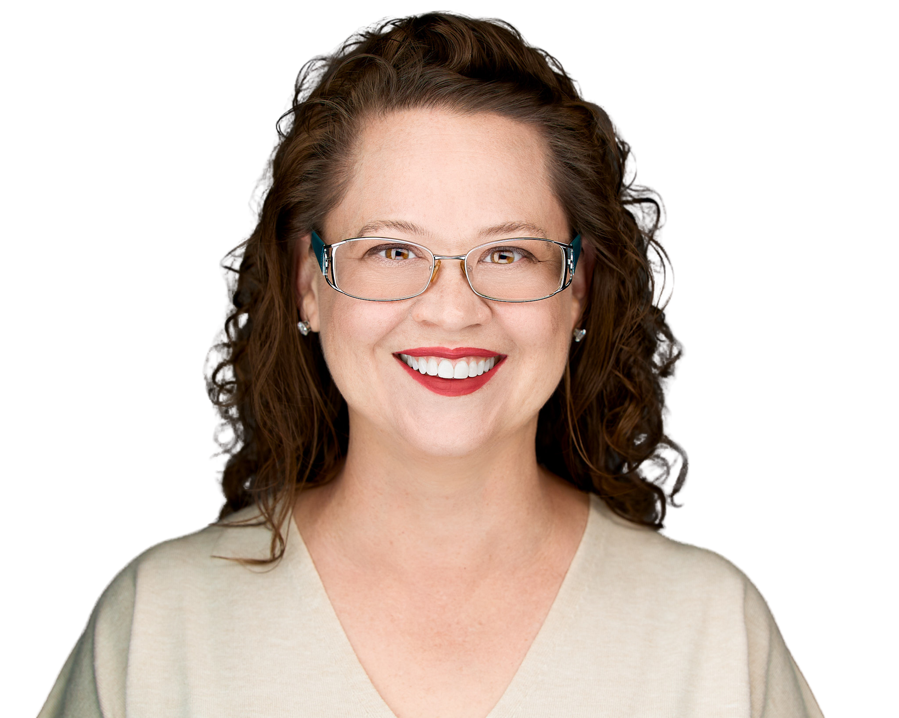
Strategic Communication:
How to Build Stakeholder
Trust & Alignment

Slide 2
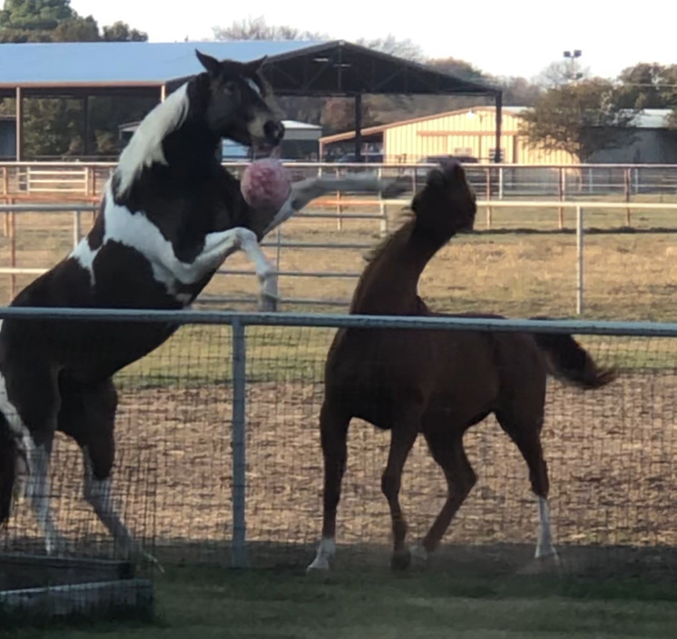
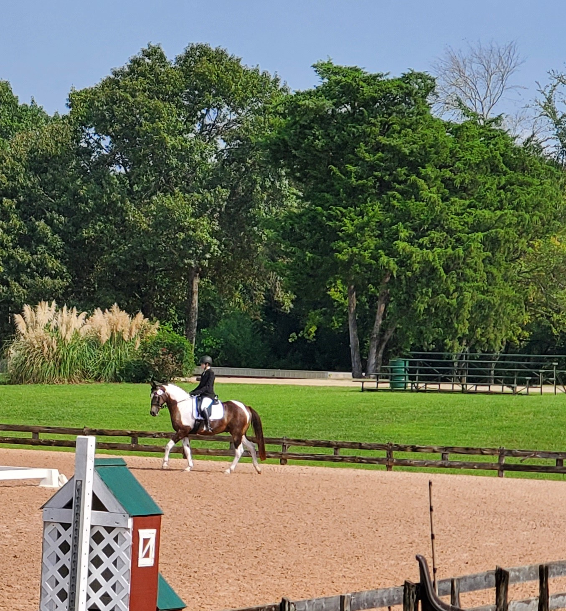

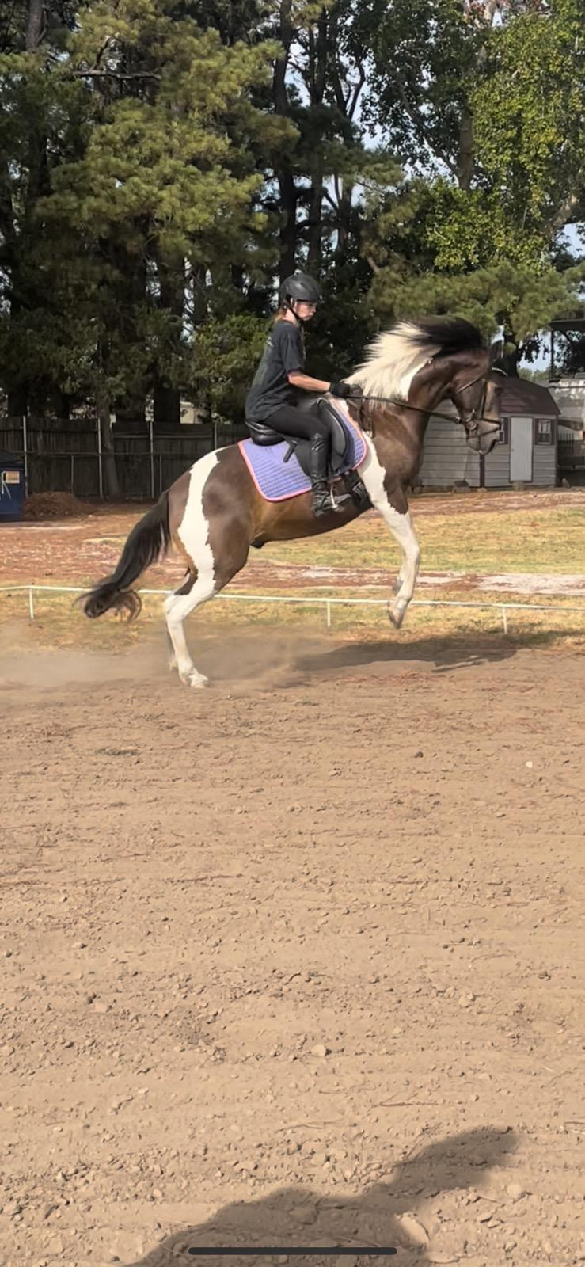
Trust &
Alignment
in Action

Slide 3
ST^KFHQLDFRS
Notes:
Who can tell me what this says?

Slide 4

Agenda
MECHANICS
Who: Identify Your Audience
What: Know Your Message
When: Consider Your Timing
Where: Choose Your Platform
Why: Know Your Purpose
ART
How: Determine Your Approach
Q&A
Strategic Communication:
How to Build Stakeholder Trust & Alignment
Notes:
To help accomplish that, we're going to talk about how to communicate strategically.
In my last job, I was supporting 130 business owners (with their own unique personalities and needs) and a support team of 13 people. That's a lot of different personalities and communicators to deal with. Some of them had been top executives or board members of major companies and came in with large bank accounts. Others had come from the blue collar world and put everything on the line to own a business.
Someone's education and background is another consideration when communicating clearly.
Over my career, often the hard way, I learned some valuable lessons about the mechanics and art of communication.

Slide 5
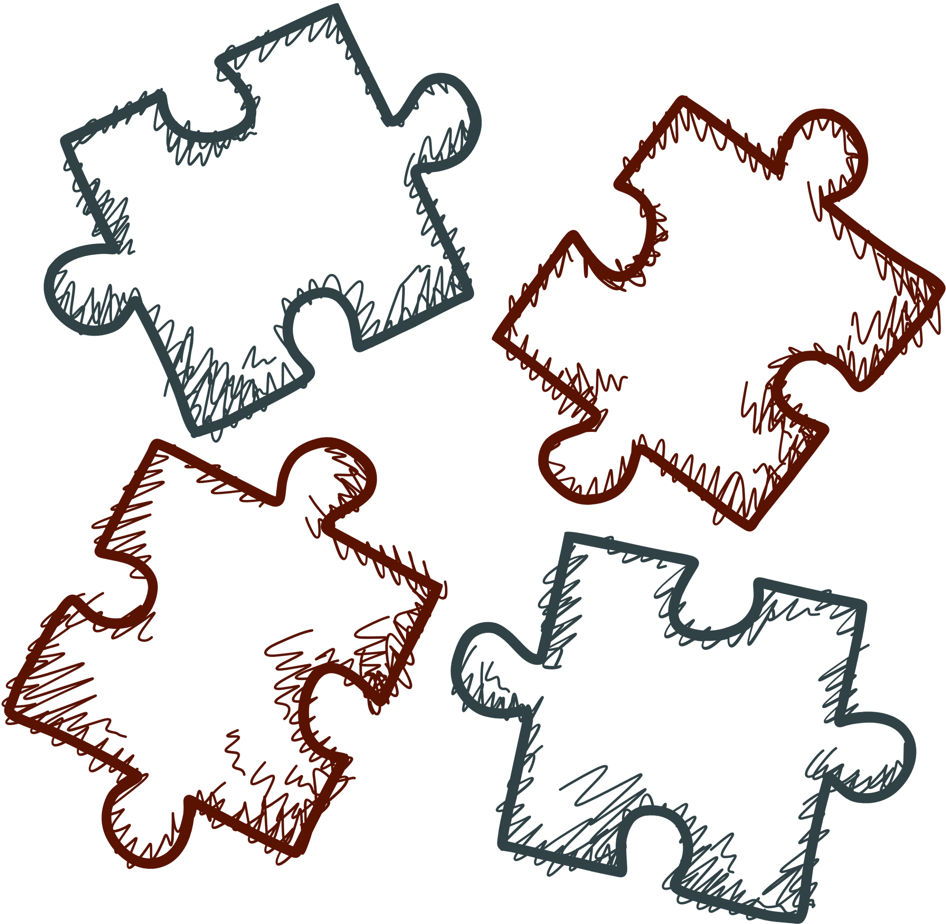
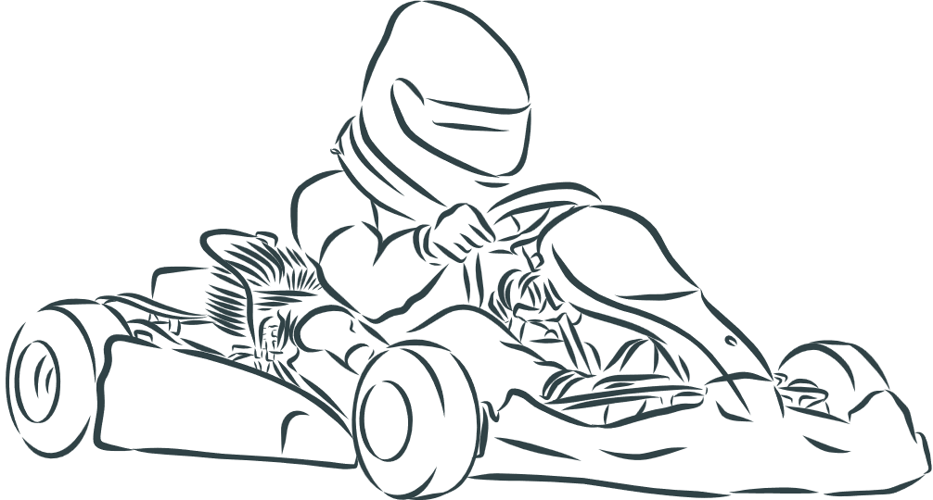



WHO:
Identify Your
Audience
Strategic Communication:
How to Build Stakeholder Trust & Alignment
Notes:
First, we need to identify our audience. This could include their rank or position or level of influence or education, but to be strategic we need to go deeper than a job title.
We're going to talk about 4 types of communicators. It's possible that you'll see yourself in more than one of them.
It's also likely that you'll feel MOST comfortable in one more than the others.
If you're not already, you're about to become multi-lingual.

Slide 6
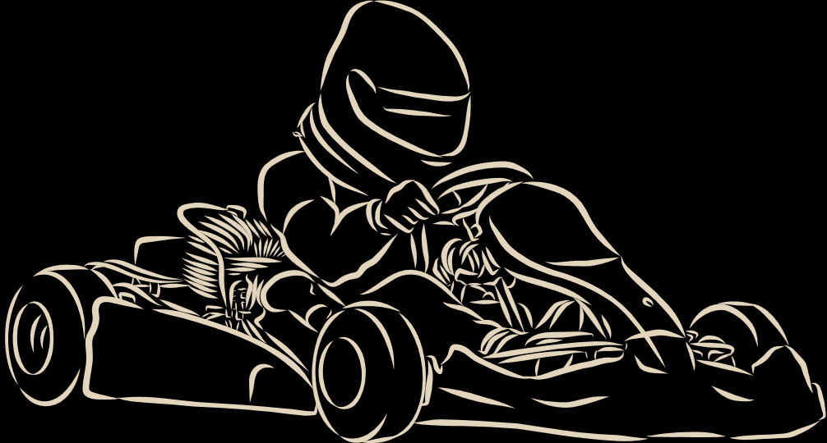
Who’s here to win the meeting before it even starts? If you're the kind who jumps to solutions, stand up.
You're a Driver.

Slide 7
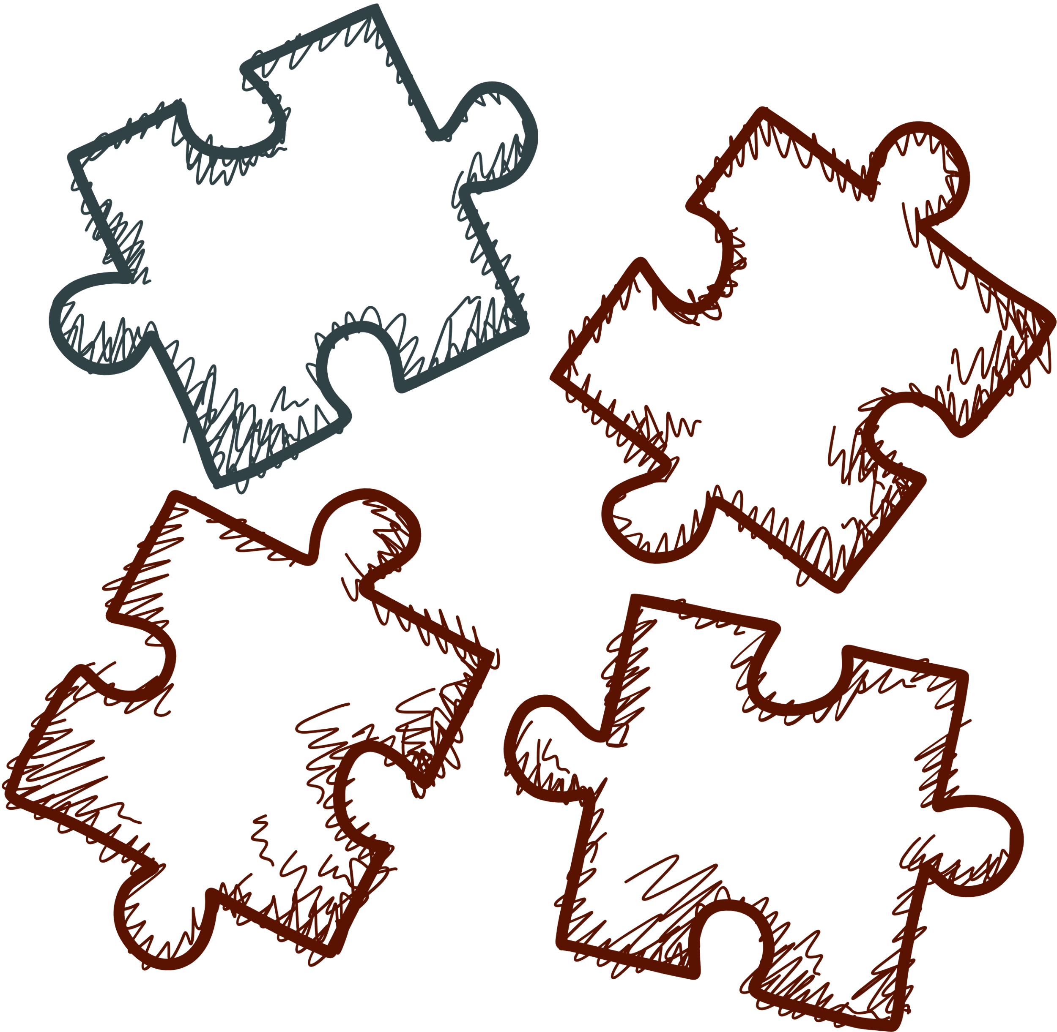
Stakeholder Types
PERSONALITY:
Driver, Dominant, Achiever
CHARACTERISTICS:
Assertive, Competitive, Results-Driven
KEYWORDS:
Win, Results, Lead
DECISION MAKING TYPE:
Quick
Strategic Communication:
How to Build Stakeholder Trust & Alignment
Notes:
Drivers are the competitive folks who when you tell them they can't do something they may challenge you to stand back and watch. They're assertive and results-driven.
In meetings you may notice they focus on results and winning, so you may kick your message off with something along the lines of "We can win 60% more market share by leading a training initiative."
You can expect quick decisions from your drivers, so it's best to get your message right the first time.
I had a stakeholder, we'll call him Ken, who was a driver type. On day one as a new member of our team, he came in and informed me how I should change our processes. You can imagine how his approach was probably not the best way to begin a new relationship. But I was able to ID him.
My advice to you Drivers, take a beat before you act.
For those of you facing a driver who wants to take control, take two beats before you respond.
Don't allow your ego and emotions to drive the train. You will almost certainly be derailed.

Slide 8

If you need data before making decisions and probably brought a color-coded planner, take a bow.
You’re an Analyzer.

Slide 9
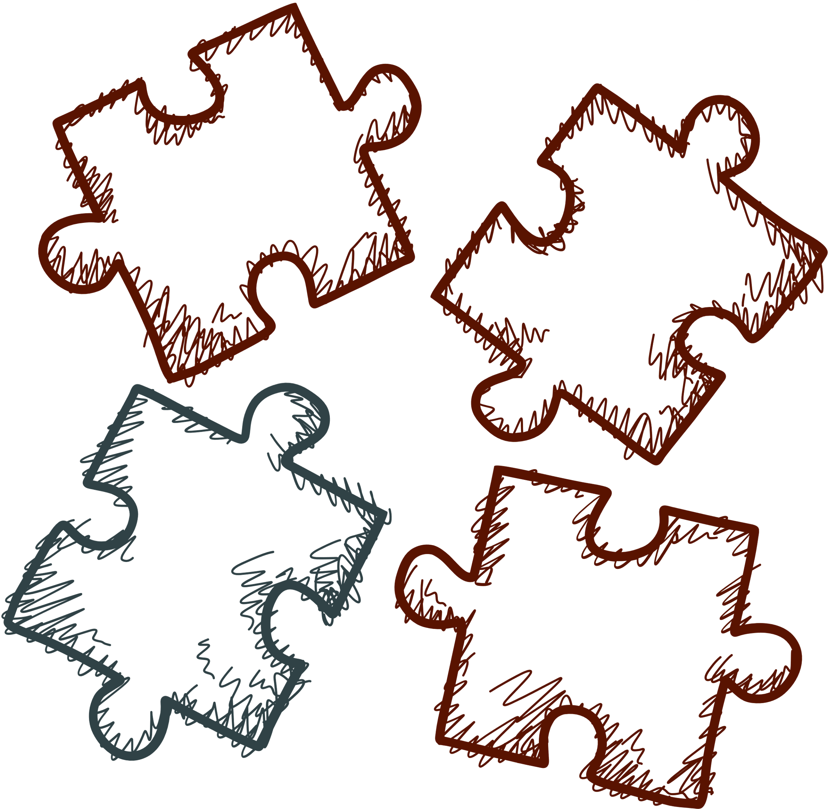

Stakeholder Types
PERSONALITY:
Analyzer, Conscientious, Accountant
CHARACTERISTICS:
Analytical, Detail-Oriented, Thoughtful
KEYWORDS:
Research, Data, Think
DECISION MAKING TYPE:
Slow
Strategic Communication:
How to Build Stakeholder Trust & Alignment
Notes:
Analyzers are your conscientious accountant types.
Like with drivers, you're going to want to get to the point pretty quickly, but be ready to provide more data so your analyzers can think things through.
Your message may be something like "based on the year over year data, we're seeing..."
Because of their need for data, these stakeholders take their time to make decisions. And they're going to ask a lot of questions.
My previous boss was one of these types. It often felt like she was slowing every process down, when in reality she was just being thorough.
Your analyzers are not the ones who are going to take large risks that feel like they're jumping off the side of a cliff. They want that security.
Be patient.

Slide 10

If you believe everything’s better with balloons and emojis, and you love to hype the team, stand and wave.
Hello, Cheerleader!

Slide 11
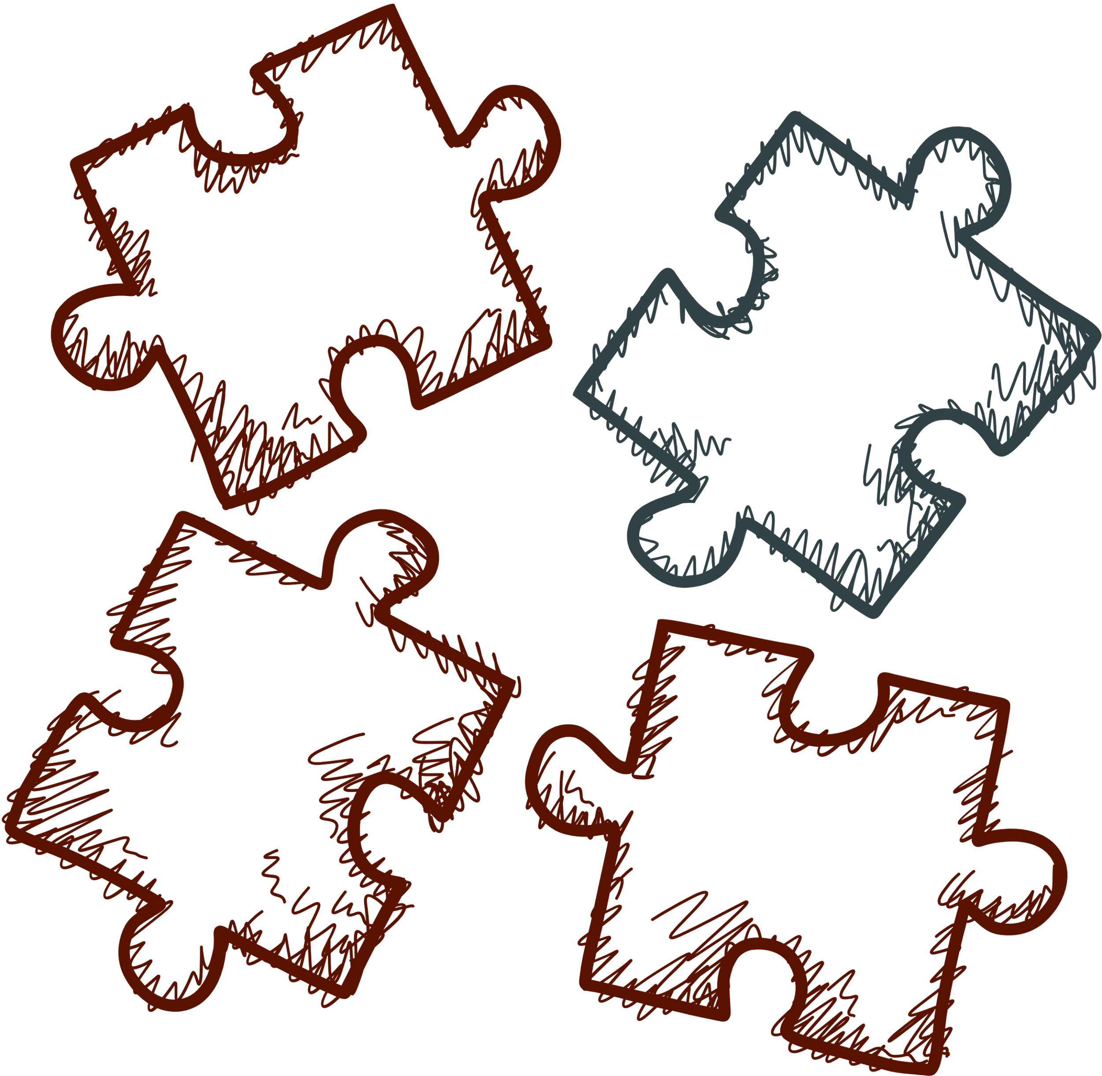

Stakeholder Types
PERSONALITY:
Cheerleader, Influencer, Connector
CHARACTERISTICS:
Energetic, Social, Adventurous
KEYWORDS:
Exciting, Fun, Compelling
DECISION MAKING TYPE:
Quick
Strategic Communication:
How to Build Stakeholder Trust & Alignment
Notes:
Cheerleaders or influencers or connectors, bring people together and influence others largely with their energy.
You don't have to become hyped up to communicate with this group, but you will want to alter your language a little to engage them. You may say something like "I'm excited by the reduction in customer complaints. The results tell a compelling story."
If you get your story right, you're likely to see a quick decision.
I had a manager who was a cheerleader type. She wanted to celebrate everything and make sure the entire team felt connected and appreciated. She loved balloons and streamers. Her brain moved fast. Following her train of thought could be a bit challenging at times, but she knew how to bring people together.

Slide 12

If you're the glue holding things together behind the scenes, making sure no one feels left out, take an often unrecognized bow.
You’re our Helpers.

Slide 13
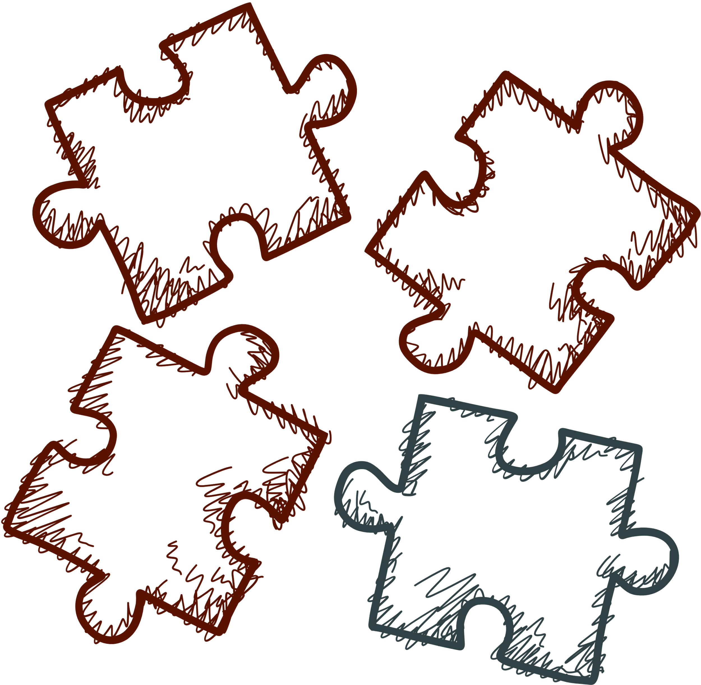
Stakeholder Types
PERSONALITY:
Helper, Steady, Librarian
CHARACTERISTICS:
Relationship-Focused, Harmony-Seekers, Compassionate
KEYWORDS:
Support, Team, Care
DECISION MAKING TYPE:
Slow
Strategic Communication:
How to Build Stakeholder Trust & Alignment
Notes:
Like the cheerleaders, Helpers are people focused and want to bring people together.
You likely know them to be the glue that holds a group together, the peacemakers, the happy-to-help types.
Your approach with these stakeholders could be something like "I'm looking for a little support. I wonder if you could help me with..."
In meetings you'll likely notice they focus on ensuring everyone on the team is taken care of and feels supported.
The helpers intersect with the analyzers in their desire for data, so you're not likely to get a quick decision here. They want to feel safe before acting.
When people first meet me they often peg me as a cheerleader or maybe a driver. In reality, this is my home base. I'm your behind the scenes gal making sure everyone and everything is taken care of.
I've just learned to speak the other languages in a way that allows me to blend in. I'm a Charma Chameleon if you will.

Slide 14
If you saw yourself in every quadrant, congratulations!
You’re a Chameleon!

Slide 15


WHAT:
Know Your Message
Strategic Communication:
How to Build Stakeholder Trust & Alignment
Notes:
Silliness aside, once you know who you're talking to, you're ready to think about the what of your message.

Slide 16
Know Your Message
WHAT’S THE GOAL?
WHAT’S AT STAKE?
WHAT’S WANTED?
WHAT’S NOT WANTED?
Strategic Communication:
How to Build Stakeholder Trust & Alignment
Notes:
To know your message, you need to know:
What’s the goal? What do you need to accomplish with your message?
What’s at stake? What will fall apart if your message isn't received clearly?
What’s wanted? What do you each stand to gain?
What’s not wanted? What do you each stand to lose?
Make sure you're answering these questions from your perspective, their perspective, and the perspective of the business or project.

Slide 17
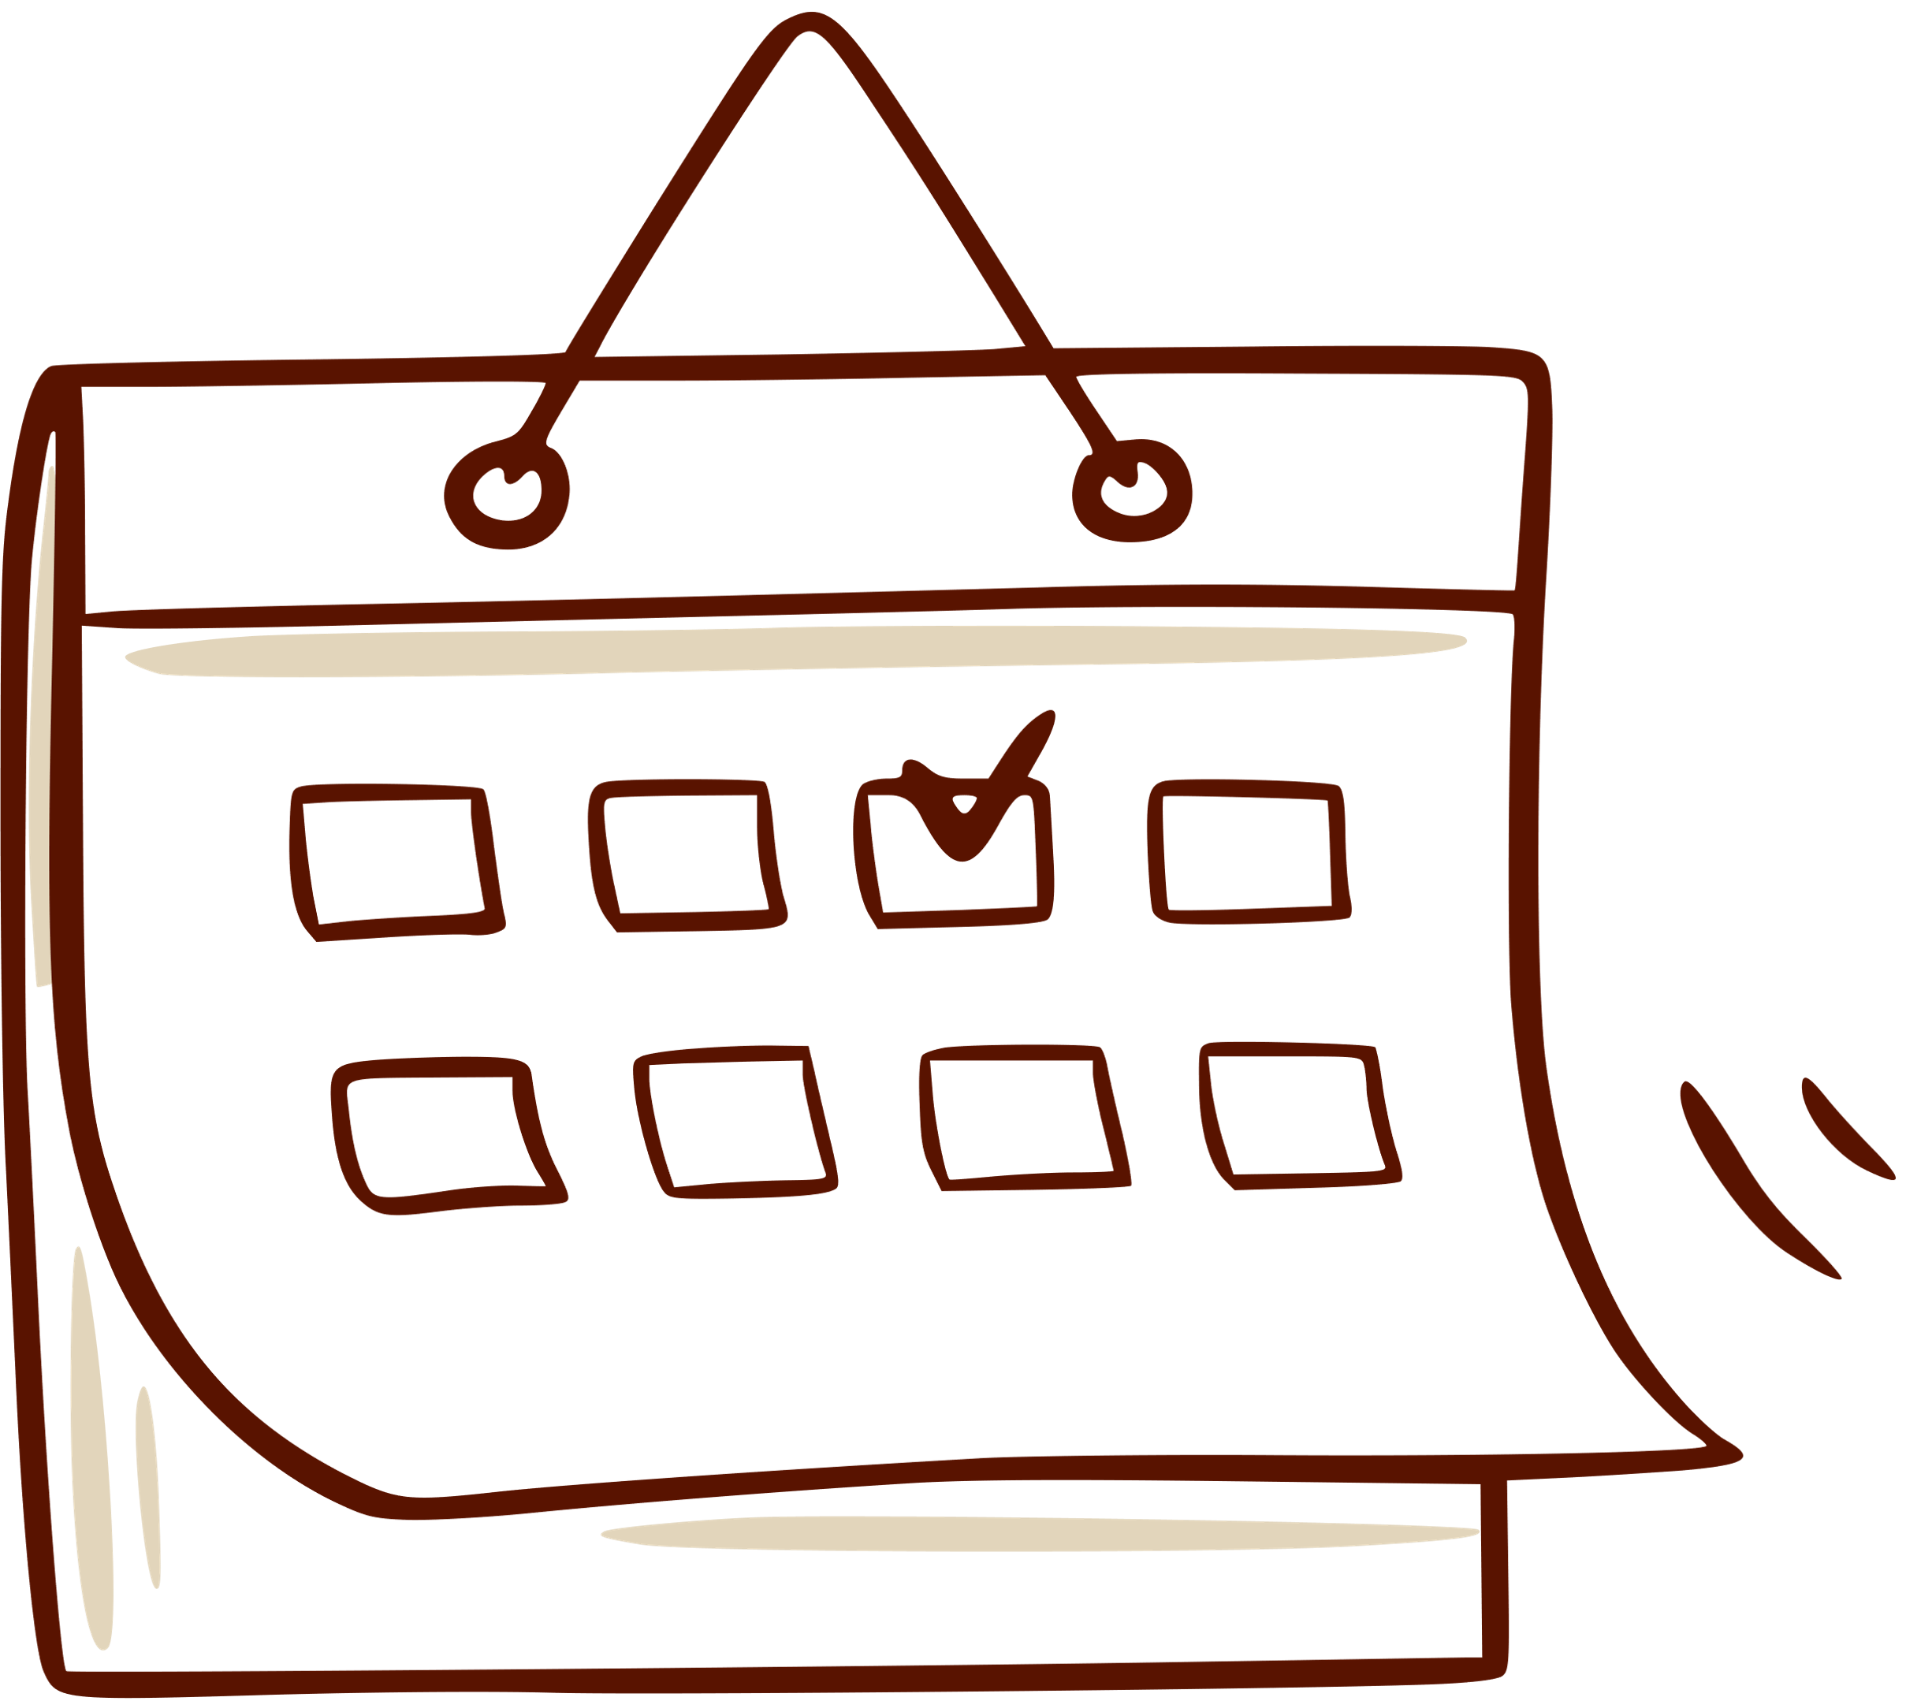

WHEN:
Consider Your Timing
Strategic Communication:
How to Build Stakeholder Trust & Alignment
Notes:
Next, determine when the message should be delivered. How does that even matter?
Think about the flow of your week.
Let's look at that, based on the assumption that you are not spending your weekends working for your job.

Slide 18
Consider Your Timing
URGENCY VS IMPORTANCE
DAY OF WEEK
TIME ZONES
DISTRACTIONS
Strategic Communication:
How to Build Stakeholder Trust & Alignment
Notes:
To really nail your timing, determine your messages urgency or importance. Just because something is important doesn't mean it's urgent.
Examples:
Urgent: “We’re hitting the project budget ceiling this week and need a decision now on whether to reallocate funds.”
Important: “We should reforecast the remaining budget to identify cost-saving opportunities and avoid overruns in later phases.”
Knowing if your message is urgent or important helps you focus in on your day of the week.
It's Monday morning. You're desperate for one more cup of caffeine before you dig into figuring out what you need to do for the week. Can that message about reforecasting your budget wait?
Fridays can be equally tricky for sending more complex messages, because people are exhausted from the week and are thinking about their weekend plans.
Time zones also impact your timing. 9:00 am in New York is 6:00 am in California. That matters.
The distractions of life and work are also great at getting in the way of people hearing what you're saying. Think about the challenges in your life that get in the way of messages. What might people on your team be facing.
Ken had a knack for calling me almost daily before the work day even began. I'd step in the shower and the phone would ring. Timing matters. Respect people's private time.

Slide 19
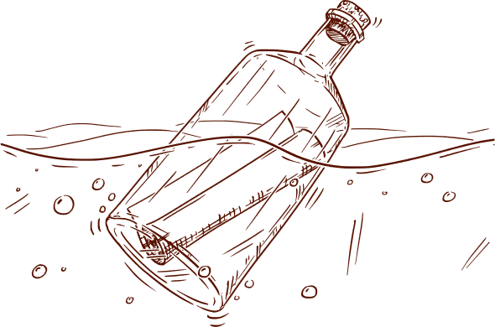
WHERE:
Choose Your Platform
Match Format to
Audience Needs
Strategic Communication:
How to Build Stakeholder Trust & Alignment
Notes:
With the who, what, and when settled, consider where to communicate.

Slide 20
Choose Your Platform
EMAIL
(Use BCC)
PHONE
(When tone matters)
VIDEO, ZOOM, OR IN-PERSON
(When facial expressions and body language matter)
Match Format to
Audience Needs
Strategic Communication:
How to Build Stakeholder Trust & Alignment
Notes:
Your delivery platform is an important consideration, because your platform will play a powerful role in tone and body language.
Email is great when facts and a written record are the most important.
When the WAY you say what needs said matters, you'll want to weigh the pros and cons of phone, Zoom, in-person, or videos like looms in an email.
No one way of delivering a message is right for every situation, so you'll need to be adaptable.
I used to work with a stakeholder whose fuse was quite short. If I wanted to guarantee an unreasonable, volatile phone call, I could send him a fact based email when things weren't going his way. I learned quickly that a phone call allowing him to hear my tone of voice immediately diffused his volatility. He'd still be upset, but his reaction was more deflated and reasonable.

Slide 21
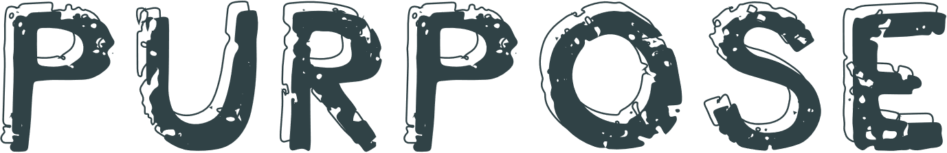

WHY:
Know Your
Purpose
Strategic Communication:
How to Build Stakeholder Trust & Alignment
Notes:
Next, we need to look at the WHY.
We all want to understand the why behind anything.
Knowing your root purpose is critical.

Slide 22
Know Your Purpose
WHY DOES THIS MESSAGE MATTER?
USE THE “5 WHYS” TO GET TO THE ROOT CAUSE.
Strategic Communication:
How to Build Stakeholder Trust & Alignment
Notes:
In this step, get inquisitive.
Wasn't Why our favorite question as a kid.
As project managers and leaders, we should be using the 5 Whys to get to a heart of a problem.
Superficial communication results in confusion and frustration. You need clarity when you communicate strategically.

Slide 23
Know Your Purpose: Example
PROBLEM STATEMENT: The print training iS IMPORTANT FOR FRANCHISE OPERATIONS.
WHY ARE FRANCHISEES RESISTANT TO THE TRAINING?
BECAUSE THEY BELIEVE THE TRAINING WILL DRAIN STAFF TIME, COST MONEY, AND REQUIRE EQUIPMENT UPGRADES .
WHY DO THEY BELIEVE IT WILL DRAIN RESOURCES AND COST MONEY?
BECAUSE THEY HAVEN’T SEEN CLEAR EVIDENCE THAT THE BENEFITS OUTWEIGH THE INVESTMENT. THEY SEE A MANDATE NOT AN OPPORTUNITY.
WHY HAVEN’T THEY SEEN CLEAR EVIDENCE OF BENEFITS?
BECAUSE TRAINING WAS ROLLED OUT AS A REQUIREMENT, FOCUSING ON COMPLIANCE RATHER THAN SHOWING ROI.
WHY WAS THE ROLLOUT FRAMED AS A REQUIREMENT INSTEAD OF AN OPPORTUNITY?
BECAUSE HISTORICALLY TRAINING INITIATIVES HAVE BEEN COMPLIANCE-DRIVEN, AND LEADERSHIP ASSUMED COMPLIANCE.
WHY IS THERE A PATTERN OF COMPLIANCE-DRIVEN ROLLOUTS?
BECAUSE THE ORGANIZATIONAL CULTURE PRIORITIZES STANDARDIZATION AND CONTROL TO PROTECT THE BRAND.
Strategic Communication:
How to Build Stakeholder Trust & Alignment
Notes:
If you're not familiar with the 5 Whys, it's a practice of asking why 5 times to get to the root cause of something.
Here is an example of the 5 whys based on a real world project I led.

Slide 24
Know Your Purpose: Example
PROBLEM STATEMENT: The print training iS IMPORTANT FOR FRANCHISE OPERATIONS.
ROOT CAUSE
RESISTANCE ARISES FROM A LACK OF TRUST AND PROOF: FRANCHISEES AREN’T CONVINCED THE TRAINING WILL BRING TANGIBLE FINANCIAL BENEFITS AND FEEL IT’S BEING FORCED UPON THEM WITHOUT COLLABORATION OR EVIDENCE.
Shape or Shift The Narrative
Strategic Communication:
How to Build Stakeholder Trust & Alignment
Notes:
With the Root Cause of our purpose identified, we can shape or shift the narrative appropriately.

Slide 25


PUTTING
IT ALL
TOGETHER
Strategic Communication:
How to Build Stakeholder Trust & Alignment
Notes:
To put it all together, we'll revisit the who and take into account our 5 Whys and Root Cause.
This analytical approach helps frame consistent communications without ego and emotion, while considering the recipient's perspective.
When you're communicating with your voice or in person, remain calm, confidant, and use eye contact.
When you're communicating in writing, try to frame your message so they can hear your speaking tone. That's tricky.

Slide 26
Driver, Dominant, Achiever
PREFERRED APPROACH:
Fast-paced, results-focused, decisive
TO COMMUNICATE:
Lead with the bottom line
Keep it brief, focused, and action-oriented
Skip the fluff
Highlight metrics, decisions, and next steps
PITFALL TO AVOID:
Overexplaining or slowing them down
Strategic Communication:
How to Build Stakeholder Trust & Alignment

Slide 27
Analyzer, Conscientious, Accountant
PREFERRED APPROACH:
Analytical, logical, risk-averse, systems-oriented
to COMMUNICATE:
Share data, logic, and the “why” behind decisions
Be precise and methodical
Provide written follow-up for reference
PITFALL TO AVOID:
Vague language or emotional appeals w/out evidence
Strategic Communication:
How to Build Stakeholder Trust & Alignment
Notes:
Your approach to accountant types can be very similar to that of a driver. You'll just need to incorporate a little more data, maybe a bar chart, and focus more heavily on the why behind the message.

Slide 28
Cheerleader, Influencer, Connector
PREFERRED APPROACH:
Energetic, people-focused, expressive
TO COMMUNICATE:
Be warm and personable
Use stories, visuals, or enthusiasm to convey messages
Tie messages to team wins or positive outcomes
PITFALL TO AVOID:
Being overly formal or emotionally distant
Strategic Communication:
How to Build Stakeholder Trust & Alignment
Notes:
With your cheerleaders, you can add a little fun into your language or tone. Memes, images, and stories convert well with this group. They want to feel a connection.

Slide 29
Helper, Steady, Librarian
PREFERRED APPROACH:
Thoughtful, reserved, detail-focused, cautious
TO COMMUNICATE:
Provide clear, well-structured information
Allow time for processing and reflection
Support statements with documentation or precedent
PITFALL TO AVOID:
Pressuring for quick decisions or skipping over details
Strategic Communication:
How to Build Stakeholder Trust & Alignment
Notes:
Like cheerleaders, librarians want to feel a connection. They like more flowery, softer language, but keep it structured.

Slide 30
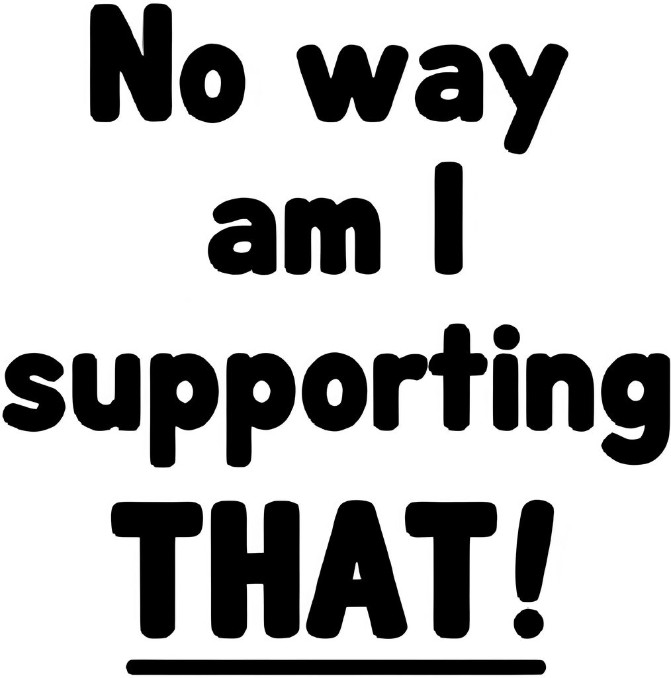

UNIVERSAL DIFFUSERS:
Validation (show you hear and respect their concern).
Reframing (connect training to their values: results, clarity, energy, or support).
Assurance (no cost, no equipment, no hidden burden).
Partnership (inviting collaboration, ownership, or shared success).
Strategic Communication:
How to Build Stakeholder Trust & Alignment
Notes:
So, what happens when all your thoughtfully crafted communications still result in resistance?
I faced that more than once and it was tempting to respond with something like "your franchise agreement requires it" which really was no better than "because I said so".
I had to dig for a more meaningful, to them, reason.
Sometimes it's like walking a highwire with no net.
When you figure it out, the results are powerful.

Slide 31

Results
Our Print Training Project?
• EVERY locations was trained to the minimum requirement.
• Multiple stores trained their entire staff.
• Teams were equipped with foundational knowledge that impacted execution.
• Local network's market share increased more than 60%.
• Over 10 years later, we maintained 97% compliance.
Strategic Communication:
How to Build Stakeholder Trust & Alignment

Slide 32
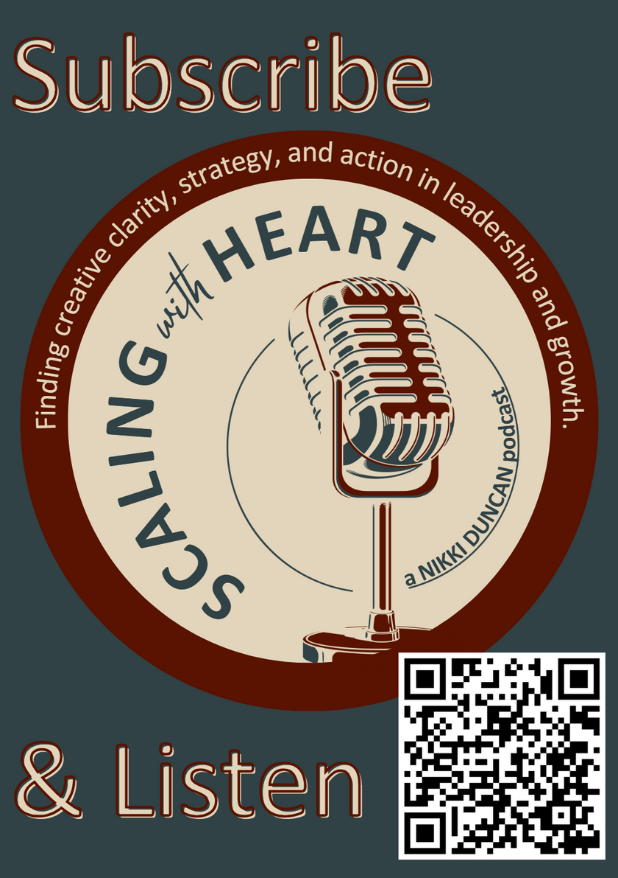
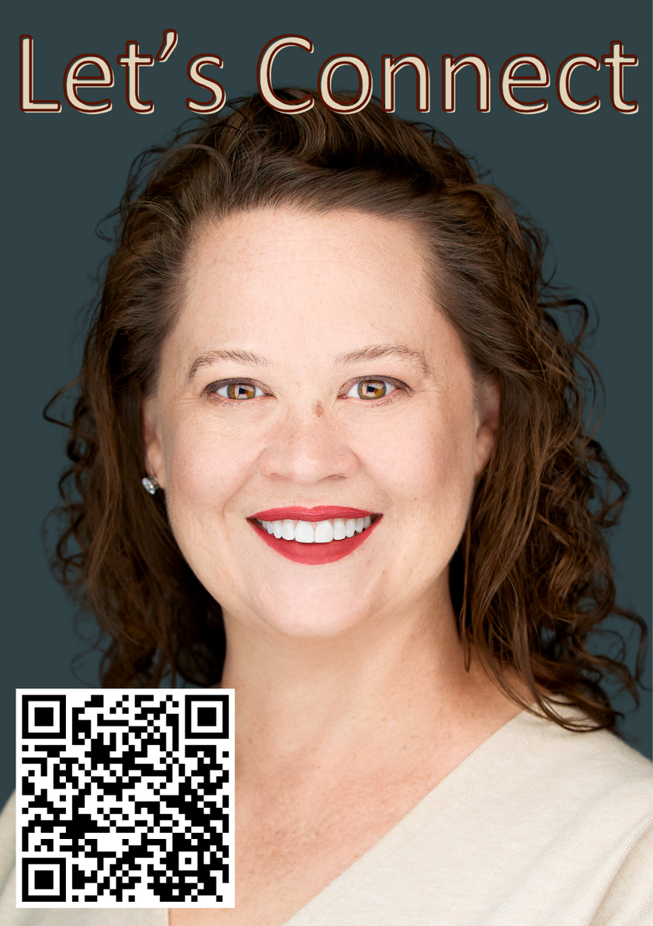
Strategic Communication:
How to Build Stakeholder Trust & Alignment
Notes:
Strategic communications have played a huge role in my career.
I'm honored to have been invited to be here today and hope I helped someone gain clarity in how to communicate.
I'm looking for my next remote role in Business and Strategic Operations Management, so if anyone has any leads I would love to hear from you!
Let's connect and keep building together.

Slide 33

There’s a message in your words, it’s plain to see.
If I listened to you now, what would they be?
I’m a man without conviction,
I’m a voice that doesn’t know,
How to sell communication.
You weave and flow, you weave and flow…
Charma, Charma, Charma, Charma, Charma Chameleon,
You weave and flow, you weave and flow…
Talking will be easy when your words are like my words
Slack, Zoom and Teams...
Slack, Zoom and Teams.

Slide 34

QUESTIONS
Strategic Communication:
How to Build Stakeholder Trust & Alignment

